Slide 1




dabl
Automatic ML with a human in the loop
https://amueller.github.io/dabl
Andreas Müller
Associate Research Scientist
Columbia University
Scikit-learn Technical Committee

Slide 2
A real world ML workflow
Data Cleaning
Visualization
Model Building
Data Collection
Model Interpretation
business/science evaluation

Slide 3
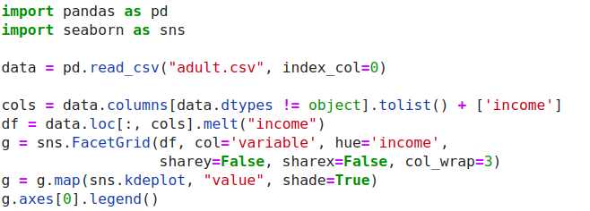
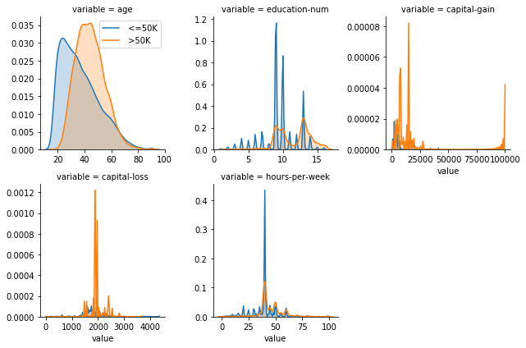
ML with sklearn & pandas

Slide 4
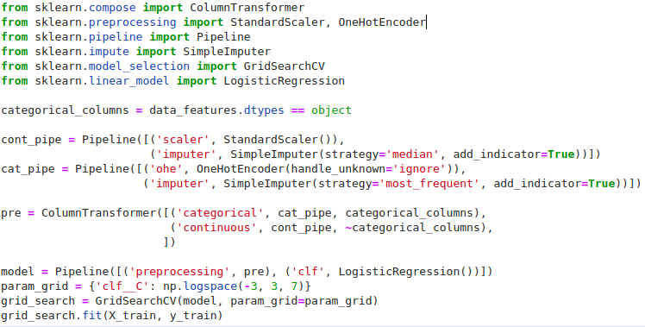
ML with sklearn & pandas

Slide 5


Slide 6
data
analysis
baseline
library

Slide 7
dabl.clean
dabl.plot
Data Cleaning
Visualization
Model Building
Data Collection
dabl. AnyClassifier
Model Interpretation
business/science evaluation
dabl.explain
You actually have to think, sorry.

Slide 8
Data cleaning
& preprocessing

Slide 9
dabl.clean
Detect types (can overwrite)
Detect Missing / rare values
Detect ordinal vs categorical
Detect near-constant
Detect index

Slide 10
Visualization

Slide 11
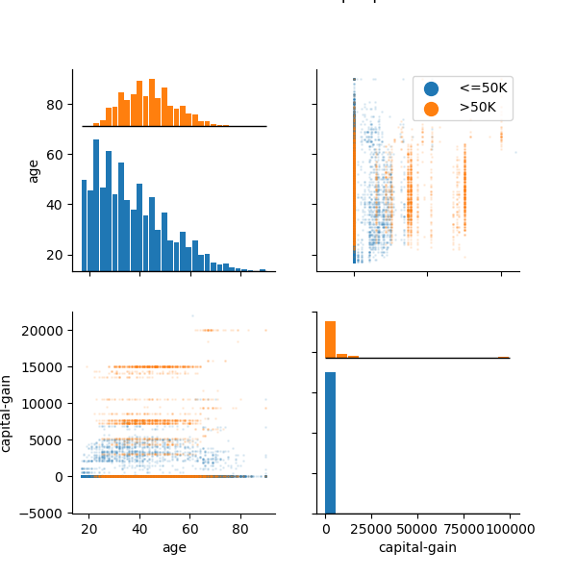
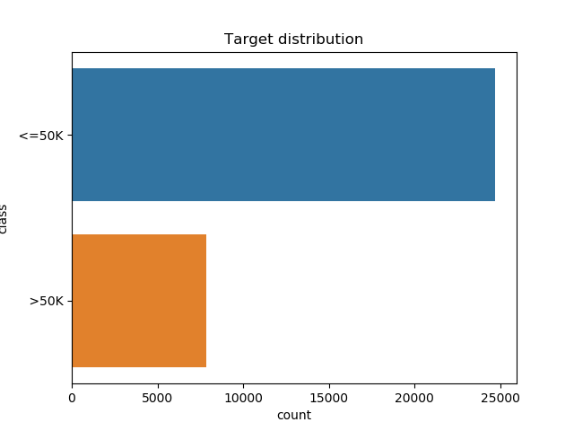
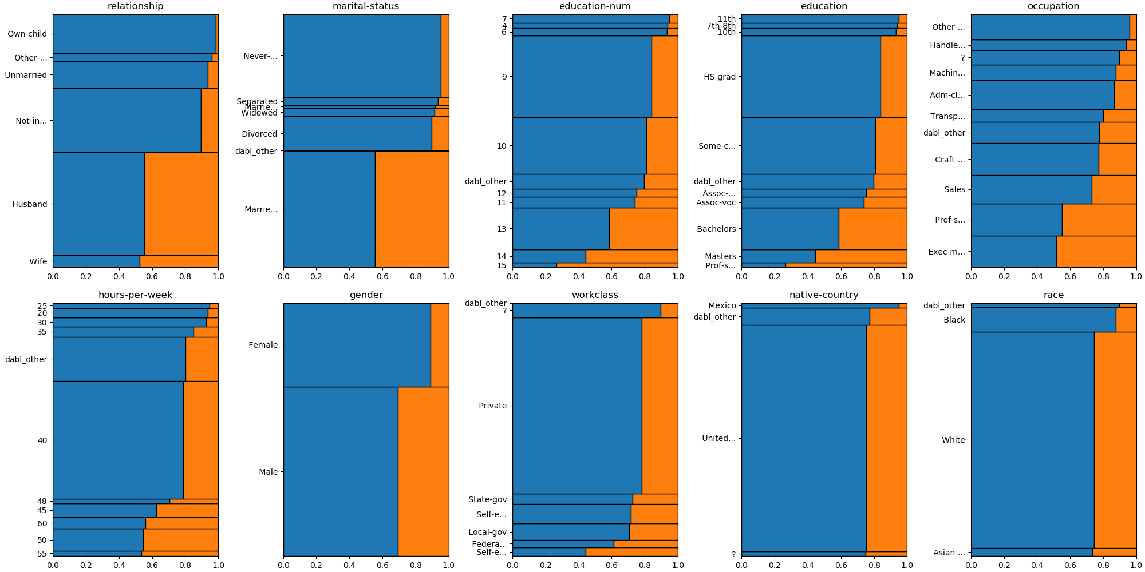
data = pd.read_csv("adult.csv", index_col=0)
plot(data, 'income', scatter_alpha=.1)

Slide 12
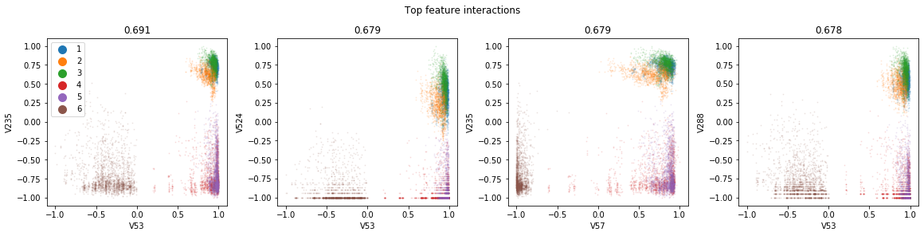
Pairwise Plots

Slide 13
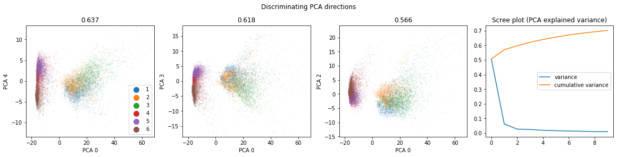
Principal Component Analysis

Slide 14
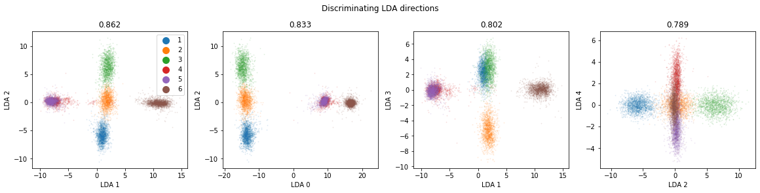
Linear Discriminant Analysis

Slide 15
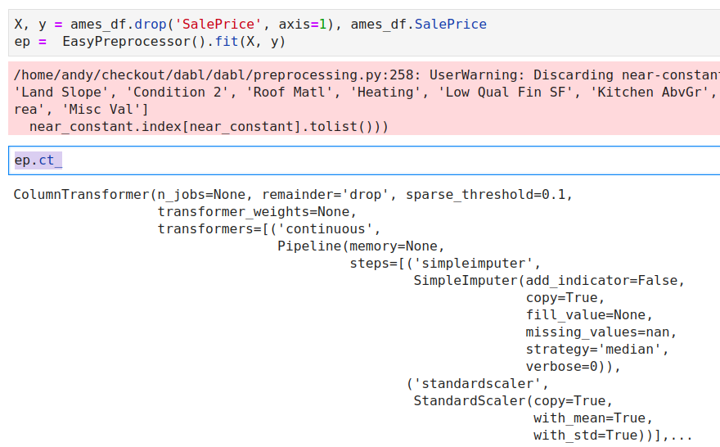
Preprocessing

Slide 16
Simple Prototypes

Slide 17
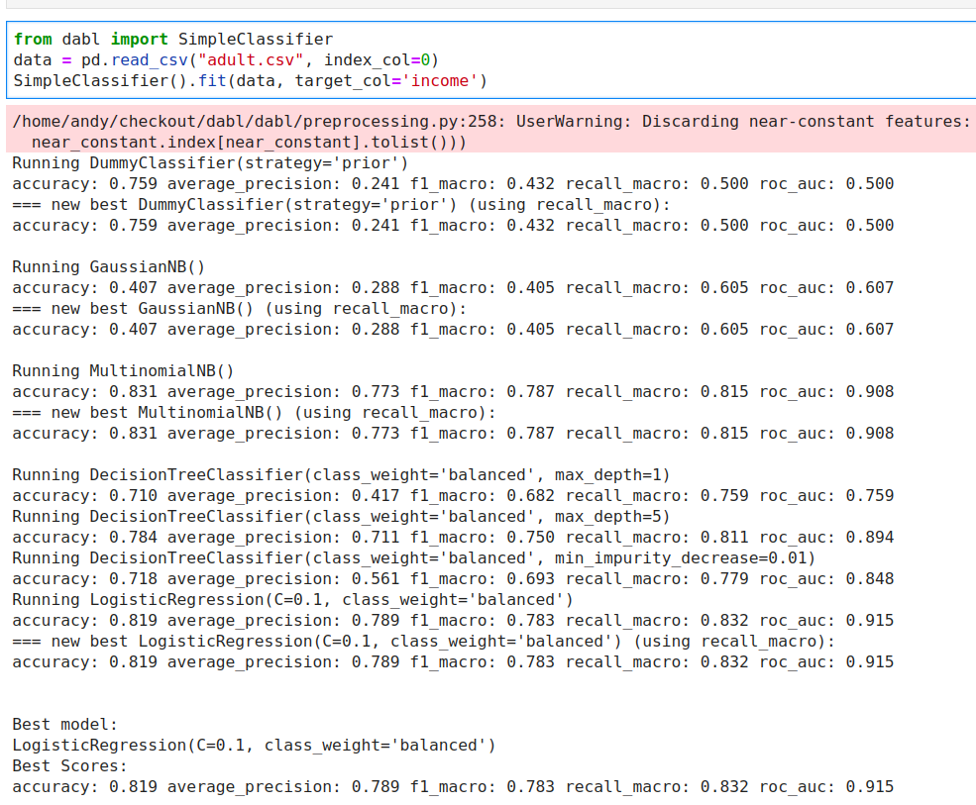
Either X, y
Or dataframe, target_col

Slide 18
Automatic Model Search

Slide 19
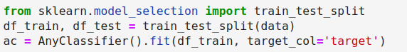
Successive Halving on a fixed, diverse portfolio:

Slide 20
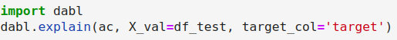

Slide 21
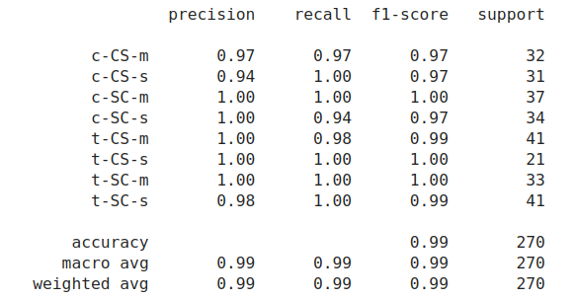
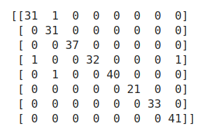
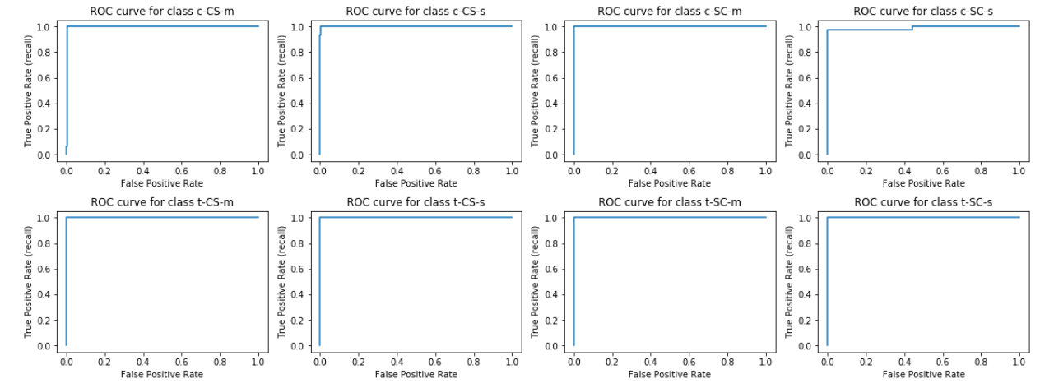
Metrics

Slide 22
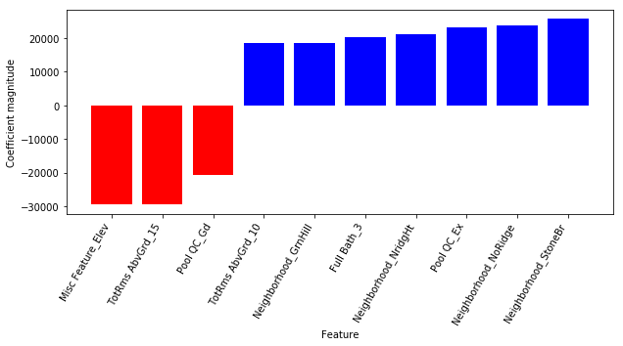
Coefficients / Feature importances

Slide 23
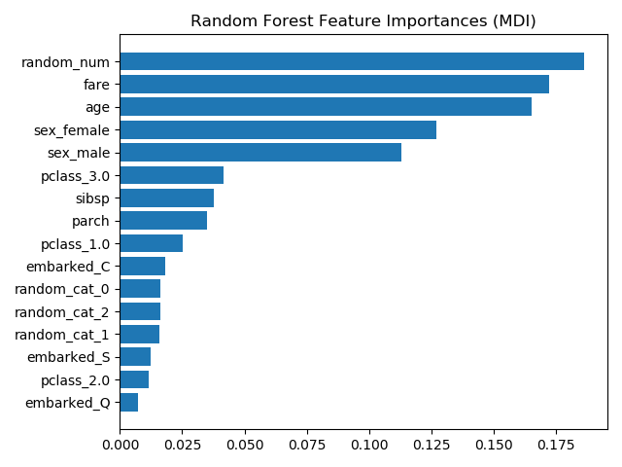
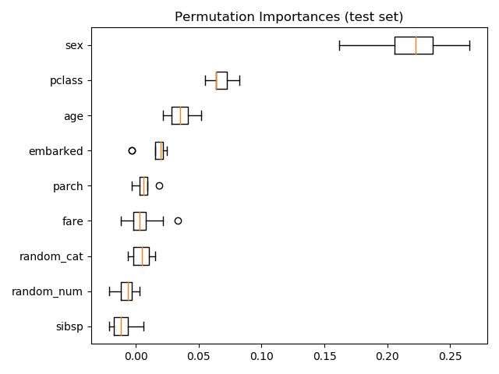
Permutation Importance
https://scikit-learn.org/dev/auto_examples/inspection/plot_permutation_importance.html

Slide 24
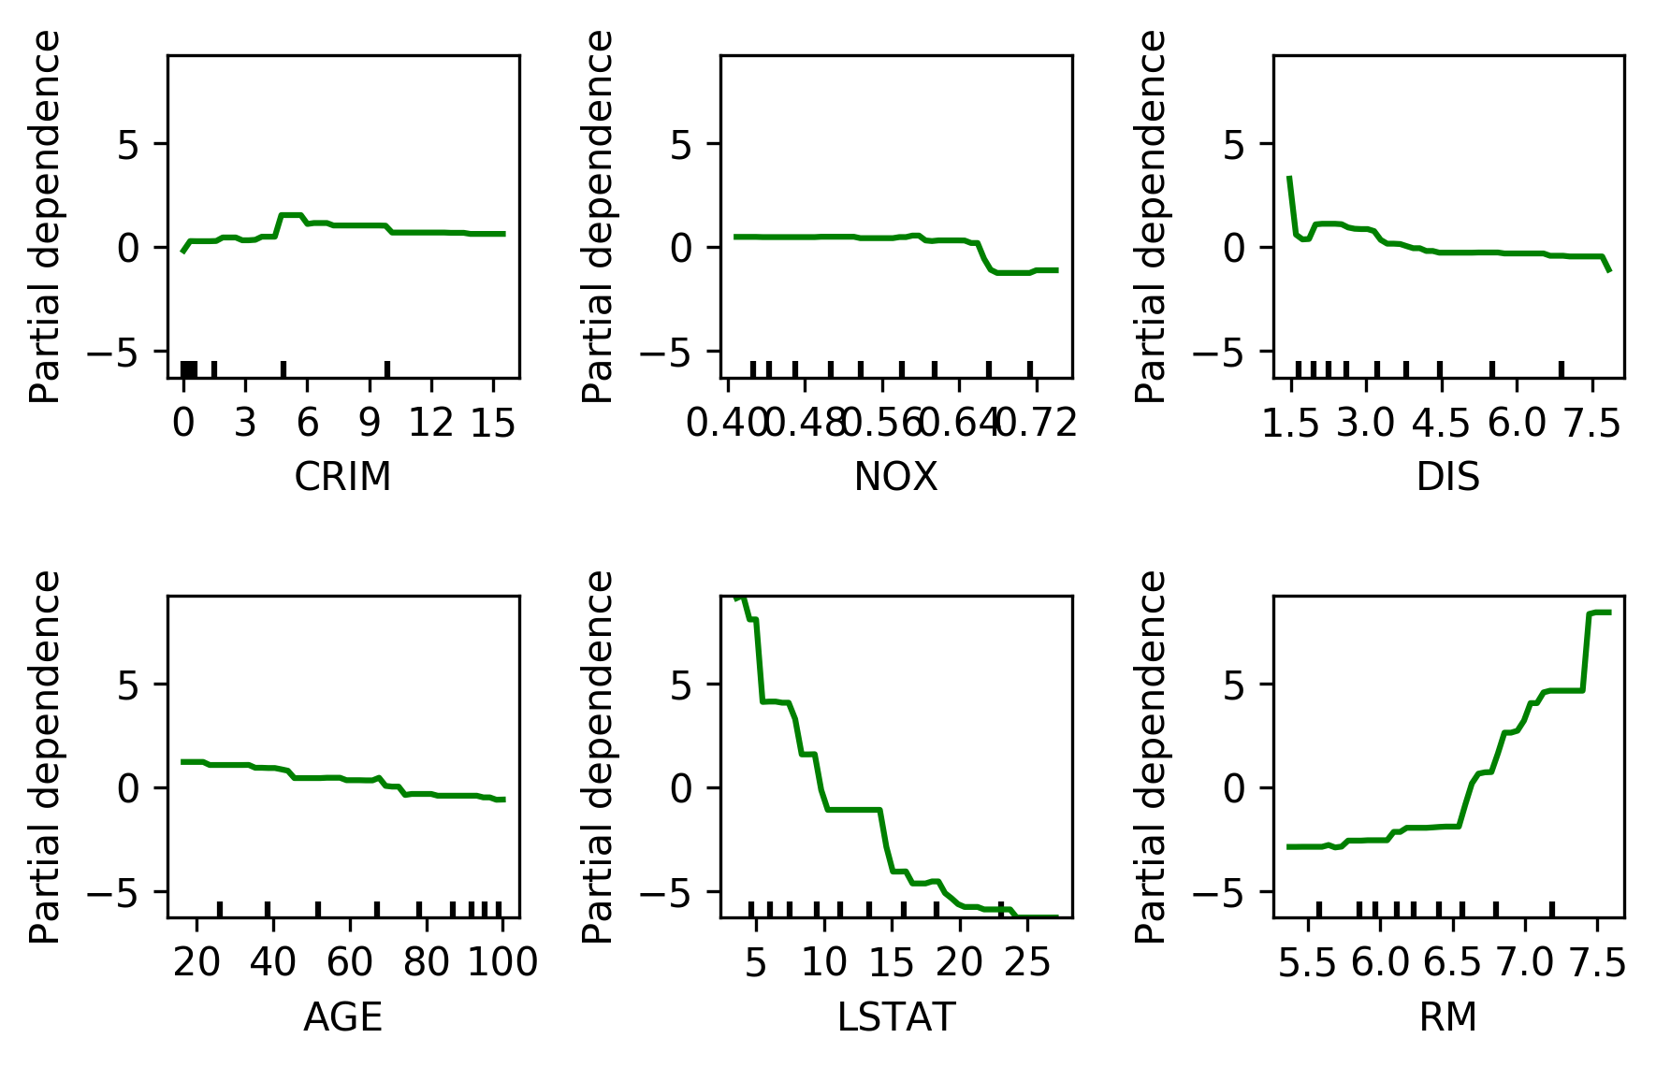
Partial Dependence Plots

Slide 25


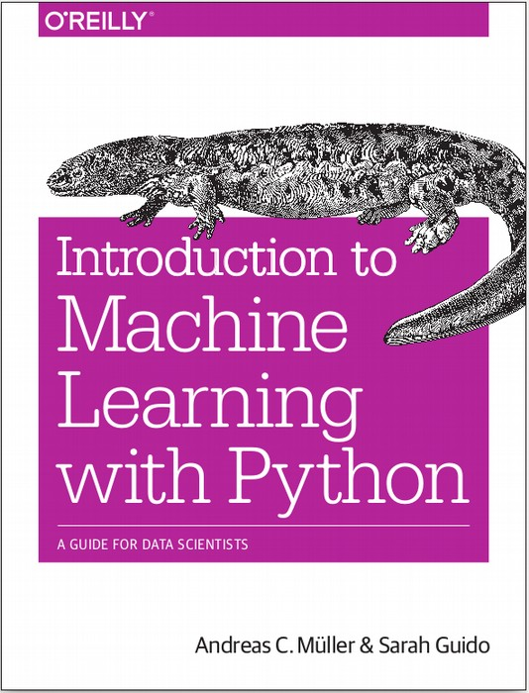


$ pip install dabl
amueller.github.io
@amuellerml
@amueller
andreas.mueller
@columbia.com
https://amueller.github.io/dabl
Notes:
Thank you for your attention and I’m happy to take any questions!

